Slide 1
SharePoint Framework M11
Jenkins NS
@jenkinsns

Slide 2

Agenda
Module 11: Single Page Application (SPA) React JS
Single Page Application in SPFx
Routing components
Applying Routing
Router implementation
Routing concerns
Advanced Routing
Redux overview
Implementing Redux
Lab 1: Create a SPFx with routing
Lab 2: Create a SPFx with Redux

Slide 3
Single Page Application In SPFx
What is a Single Page Application?
An SPA is a web application which will dynamically update your changes in the DOM without reloading the page itself.
When you have one or more components and you want to switch between these components, but you don’t want the page to reload every time, then the ideal approach for this is SPA.
Integrating SPA with SPFx
Coming back to our code, one of the important modules in Single Page Applications is Router.
Router takes care of the path to redirect a particular component.
Open the command prompt and go to your project directory.
Now, install
“npm i react-router-dom”

Slide 4
Using single part app pages in SharePoint Online
Single part app pages provide a capability to host SharePoint Framework web parts or Microsoft Teams applications in SharePoint Online with a locked layout. End users cannot modify or configure the page that is using the Single Part App Page layout.
App pages have following characteristics:
Single Part App Pages cannot be edited by end users using a browser
Currently supports hosting only single web part or Microsoft Teams application
End users can create new app pages using the New > Page experience available in modern sites.
Developers can change page layout programmatically from normal page layout to a Single Page App Page
There's no New experience in a Single Page App Page. End users can create new Article pages or Single Page App pages by using the New/page experience present in the ribbon of any modern article pages.
App pages are exposed as an option in the modern page creation capability when you chose the used page layout for your page. All web parts that have been configured to be available also as an app page are available on the Create page capability.
Web part can be configured to be exposed as an app page. This configuration is done in the web part manifest file by adjusting the supportedHosts value. Web part will be exposed as an option in the upcoming app pages picker user interface, if the supportedHosts value contains "SharePointFullPage" value.
{ // ...
"requiresCustomScript": false,
"supportedHosts": ["SharePointWebPart", "SharePointFullPage", "TeamsTab"], "preconfiguredEntries": [{ // ... }]
}

Slide 5
How to provision Single Part App page in your tenant
As a developer, the two most common ways to provision Single Part App pages is to use PnP PowerShell or CLI for Microsoft 365.
You can use PnP PowerShell to update the page layout for the existing page with following script.
Install PnP PowerShell
Install-Module -Name PnP.PowerShell
Connect-PnPOnline -Url https://spfxvodafone.sharepoint.com/sites/SPFXTraining -UseWebLogin
Set-PnPClientSidePage -Identity "Page" -LayoutType SingleWebPartAppPage

Slide 6
Routing
Routing components

Slide 7
Routing
React Component
public render(): React.ReactElement<IFirstreactrouterProps> {
return (
<div className={styles.firstreactrouter}>
<h1>Files Component</h1>
</div>
);
}
Route, Link, NavLink, Redirect, Prompt
HashRouter
BrowserRouter
Calling React component <About></About>
<HashRouter>
<Route path="/" exact component={SpfxCustomers}></Route>
<Route path="/Customer/:id" component={SpfxCustomerDetails}></Route>
<Route path="/CustomerFiles/" component={SpfxCustomersFiles}></Route>
<Route path="/about" component={Spfxabout}></Route>
</HashRouter>
<Route path="/newcom" render={
() => {return (<h1>Inline Component</h1>);}
}/>

Slide 8
Routers
<HashRouter>
A <Router> that uses the hash portion of the URL (i.e. window.location.hash) to keep your UI in sync with the URL.
<BrowserRouter>
A <Router> that uses the HTML5 history API (pushState, replaceState and the popstate event) to keep your UI in sync with the URL.
<Link>
Provides declarative, accessible navigation around your application.
<NavLink>
A special version of the <Link> that will add styling attributes to the rendered element when it matches the current URL.
<Prompt>
Re-exported from core Prompt
<MemoryRouter>
A <Router> that keeps the history of your “URL” in memory (does not read or write to the address bar). Useful in tests and non-browser environments like React Native.
<Redirect>
Rendering a <Redirect> will navigate to a new location. The new location will override the current location in the history stack, like server-side redirects (HTTP 3xx) do.

Slide 9
Routers
<Route>
The Route component is perhaps the most important component in React Router to understand and learn to use well. Its most basic responsibility is to render some UI when its path matches the current URL.
Route render methods
The recommended method of rendering something with a <Route> is to use children elements, as shown above. There are, however, a few other methods you can use to render something with a <Route>. These are provided mostly for supporting apps that were built with earlier versions of the router before hooks were introduced.
<Route component>
<Route render>
<Route children> function
You should use only one of these props on a given <Route>. See their explanations below to understand the differences between them.
Route props
All three render methods will be passed the same three route props
match
location
history
component
A React component to render only when the location matches. It will be rendered with route props.

Slide 10

Redux
Redux + React

Slide 11
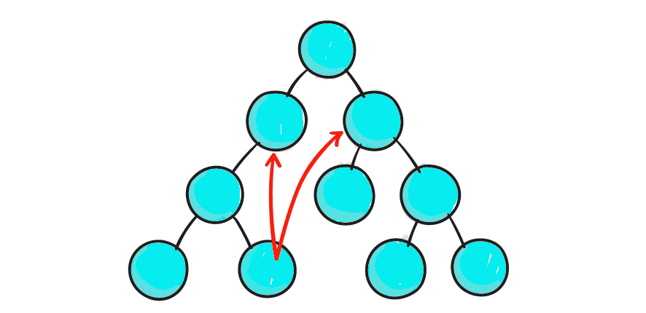
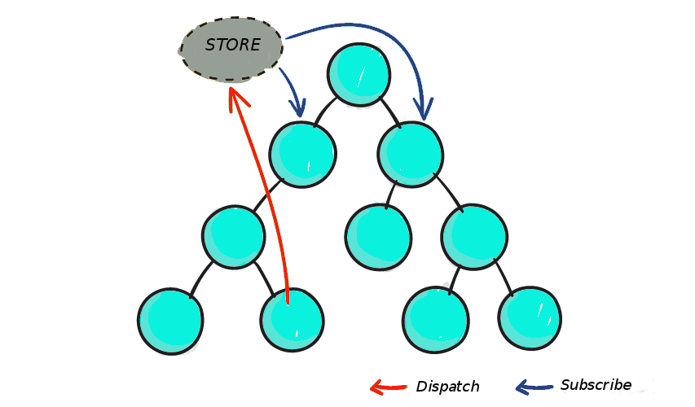
Redux
Redux is a predictable state container for JavaScript apps. The whole state of your app is stored in an object tree inside a single store. The only way to change the state tree is to emit an action, an object describing what happened. To specify how the actions transform the state tree, you write pure reducers.
Reacts data flow is such that parent components pass down props to child components
With Redux, you have got a store where you can keep all your application state. If a state change occurs in Component A, it is then relayed to the store and other components B and C that need to be aware of this change of state in Component A can subscribe to the store:

Slide 12
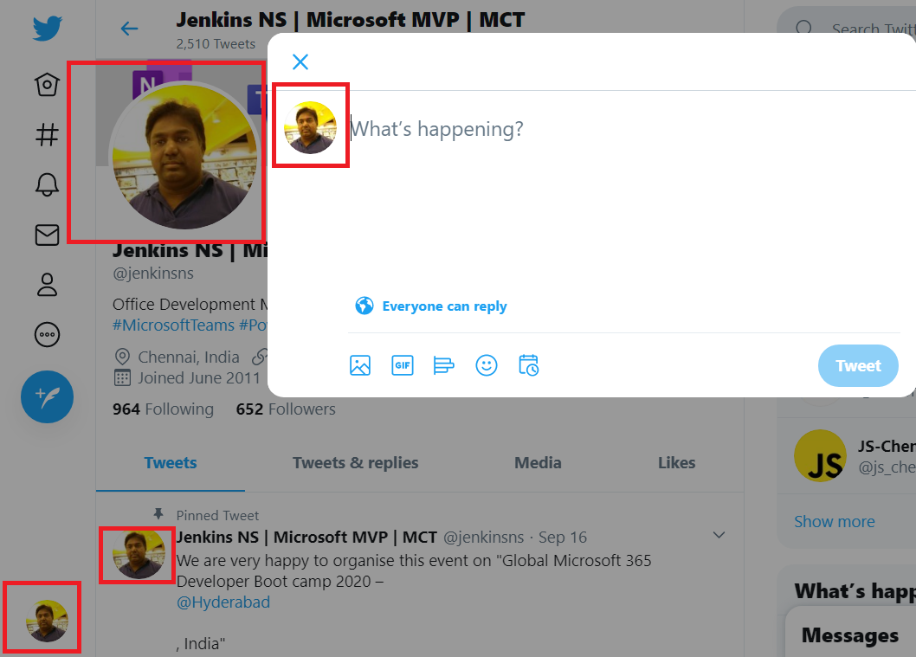
Why Redux?
If you’ve used React for more than a few minutes, you probably know about props and one-way data flow. Data is passed down the component tree via props. Given a component like this:
What we have in React
The obj, stored in App’s state, would be passed down as a prop:
Passing Data Multiple Levels is a Pain
Let’s pretend the top-level App component holds the user object in state. The user contains the current user’s avatar, handle, and other profile info.
In order to deliver the user data to all 3 Avatar components, the user needs to be woven through a bunch of intermediate components that don’t need the data

Slide 13
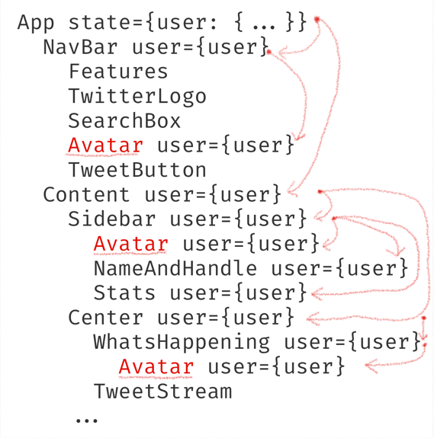
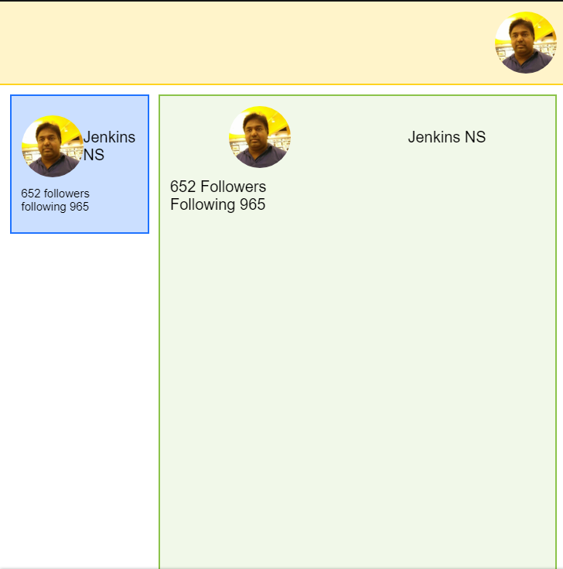
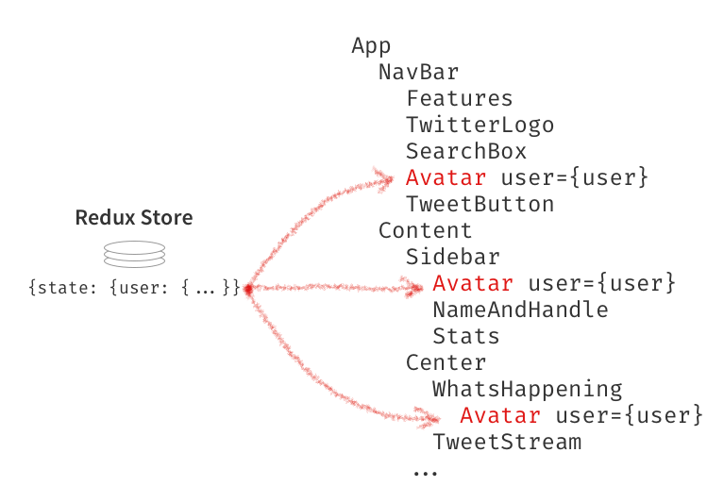
Compare React State and Redux
React State
React-Redux to Connect Data to Any Component

Slide 14
Benefits Of Redux
“Why would I need to use Redux?”. There are a few benefits of using Redux:
Predictability of outcome
There is always one source of truth, the store, with no confusion about how to sync the current state with actions and other parts of the application.
Maintainability
Having a predictable outcome and strict structure makes the code easier to maintain.
Organization
Redux is stricter about how code should be organized, which makes code more consistent and easier for a team to work with.
Server rendering
This is very useful, especially for the initial render, making for a better user experience or search engine optimization. Just pass the store created on the server to the client side.
Developer tools
Developers can track everything going on in the app in real time, from actions to state changes.
Community and ecosystem
This is a huge plus whenever you’re learning or using any library or framework. Having a community behind Redux makes it even more appealing to use.
Ease of testing
The first rule of writing testable code is to write small functions that do only one thing and that are independent. Redux’s code is mostly functions that are just that: small, pure and isolated.

Slide 15
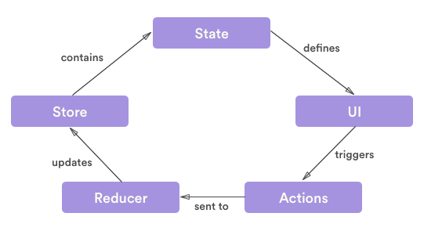
Redux with React
For a tool whose methods can be confusing for beginners at first, Redux’ s library is just 2KB and the tool itself is composed of three parts: actions, stores and reducers
Connect
Store
Reducer
Dispatch
Actions
mapDispatchToProps

Slide 16
How to Use Redux with React
npm install @reduxjs/toolkit react-redux
import { Provider } from 'react-redux’;
import { connect } from 'react-redux’;
import { createStore } from 'redux'
The react-redux library comes with 2 things: a component called Provider, and a function called connect.

Slide 17
Demo
Lab 1: Create a SPFx with routing
Lab 2: Create a SPFx with Redux

Slide 18
References
https://redux.js.org/introduction/examples

